Slide 1
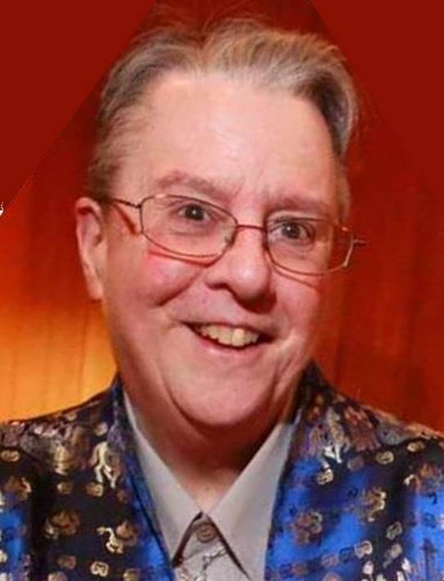
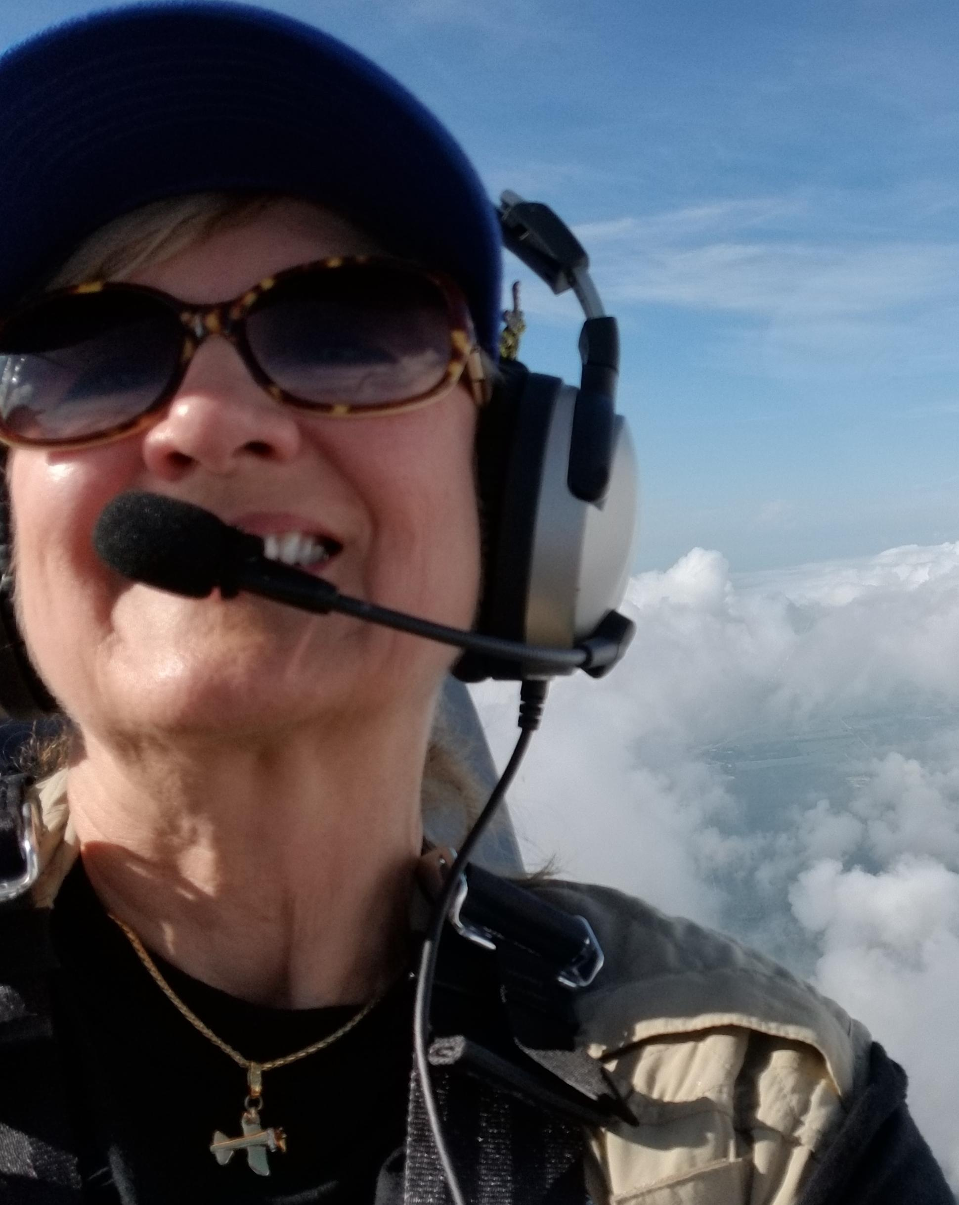

Angie Slingluff
Breakout Rm 2
(You are Here)
Breakout Room Presenters
Myra Bugsbee
Breakout Rm 1

Slide 2
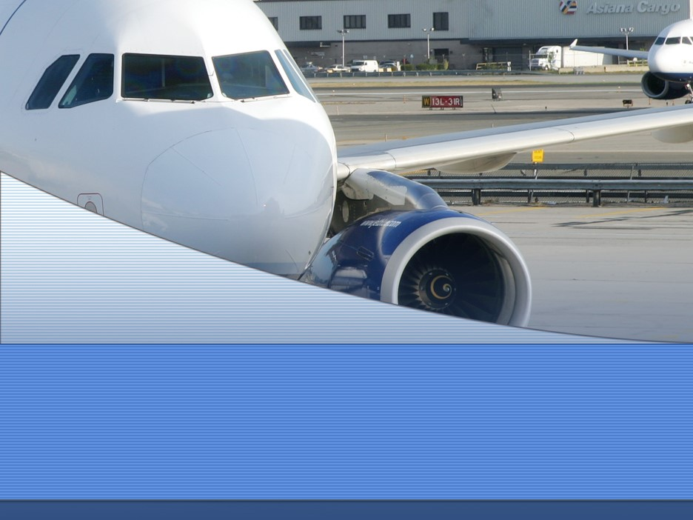

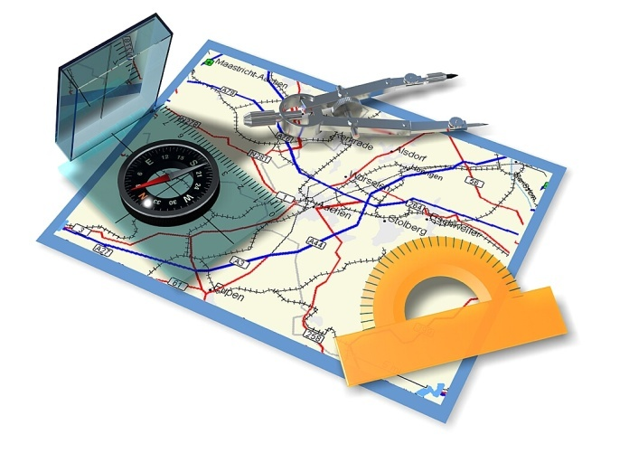
Making Community Connections
Angie Slingluff
Rio Grande Norte 99s

Slide 3
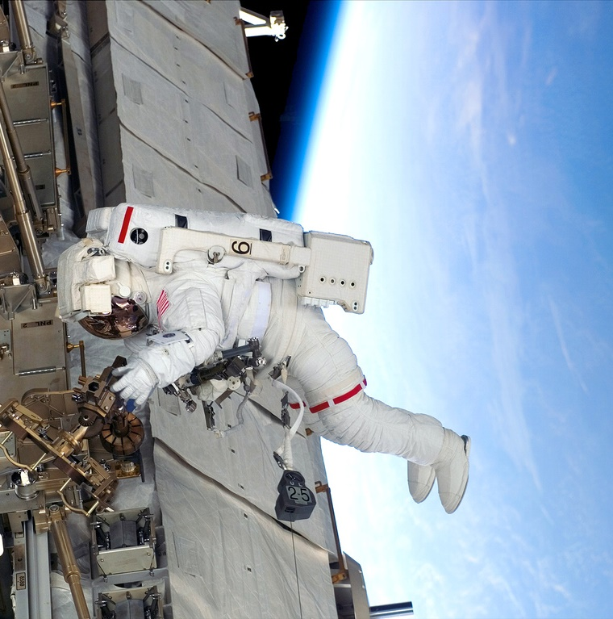
Ninety-Nines Mission
The NINETY-NINES® INTERNATIONAL ORGANIZATION OF WOMEN PILOTS®
promotes advancement of aviation through
education, scholarships, and mutual support
while honoring our unique history and
sharing our passion for flight.

Slide 4

How Do We Do it?
Develop relationships
  Within my Chapter – who will help
  Will I have helpers?
  Will I have any hands on resources
  Within my Community – who are the resources
  At my Airport: FBO, Airport Manager, ATC
  With Community Organizations: EAA, Pilot groups, Airport Association, Girl Scouts, Schools, Math & Science teachers

Slide 5
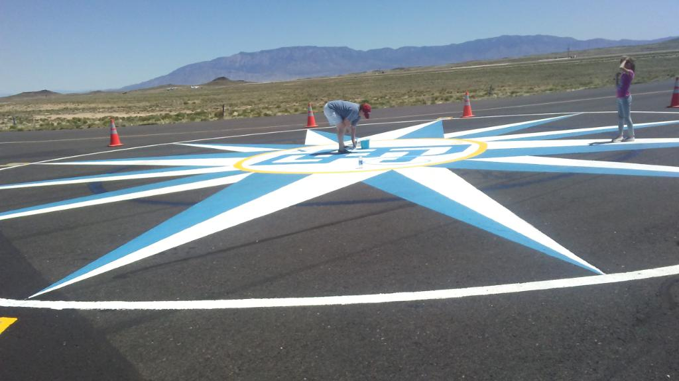
Have a Plan
Why am I doing this?
Who is my target audience?
Where will we hold the event?
When will we hold it?
Is there a contact person?
What will I present? A talk, a hands on activity, a flight?

Slide 6
Have a Plan - 2
Contact the Organization
  Set up an appointment time and place
  Tell them about the Ninety-Nines and why you want to offer your program
  The purpose of your event / activity (the mission of the 99s)
  Discuss what you expect from them (Space? POC? Additional volunteers?)
  is there a potential cost for them?

Slide 7
Preparation
Invitations / Media advertising
Will you do it or will the group you are working with do it?
Gather all you materials ahead of time and review how you will us them (handouts? Activity materials, e.g. Foam Plate Gilder, computer simulation)
Does the program need 99s insurance (flying, non-flying)

Slide 8
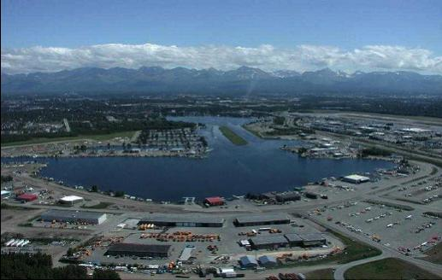
How Do I Get There?
Determine a destination
Develop a flight plan
Research the hazards
Fill your tanks
Take off for blue skies!

